Slide 1
Tennessee department of transportation utilization of accelerated bridge construction techniques
Aaron Crowley, Ph.D. KSWA
Travis Smith, P.E. TDOT
Biloxi, Mississippi
November 8, 2016

Slide 2
Accelerated bridge construction
What is ABC?
Accelerated Bridge Construction (ABC)
ABC improves/reduces
Why use ABC Technologies?
Impediments to ABC
Bridge Farm Concepts
Time Metrics for ABC
TDOT Fast Fix 8 Project
Future TDOT ABC Projects
Fun Fact about the Biloxi Bridge

Slide 3
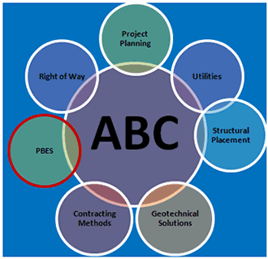
What is ABC?
ABC is a paradigm shift
Intrinsic Benefits:
Safety
Quality
Durability
Social Costs
Environmental Impacts
From the Owner Agency, perspective may require a change in how a project is approached and how it is justified

Slide 4
ABC innovation – every day counts
ABC is bridge construction that uses innovative planning, design, materials, and construction methods.
ABC improves:
Site Constructability
Total Project Delivery Time
Work-Zone safety for the traveling public
ABC reduces:
Traffic Impacts
Onsite Construction Time
Weather-Related Time Delays

Slide 5
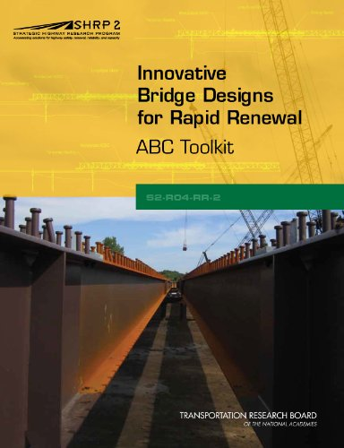
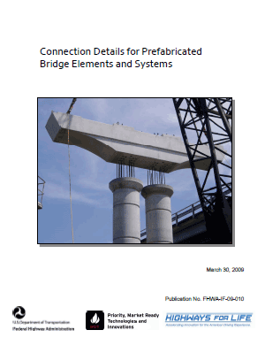
Why use abc technologies?
“ABC costs more than conventional”
Owner can’t capture user cost savings
Contractors have a “CIP culture”
Limited early involvement by contractors (legislative limitations)
Durable details are critical

Slide 6
Why use abc technologies?
Approximately one-fourth of the Nation’s 600,000 bridges require rehabilitation, repair, or total replacement.

Slide 7
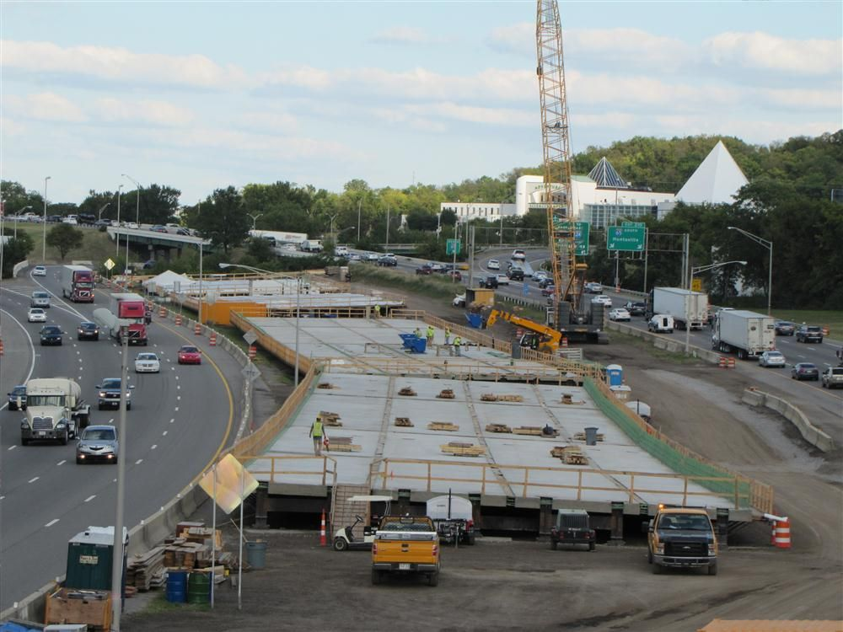
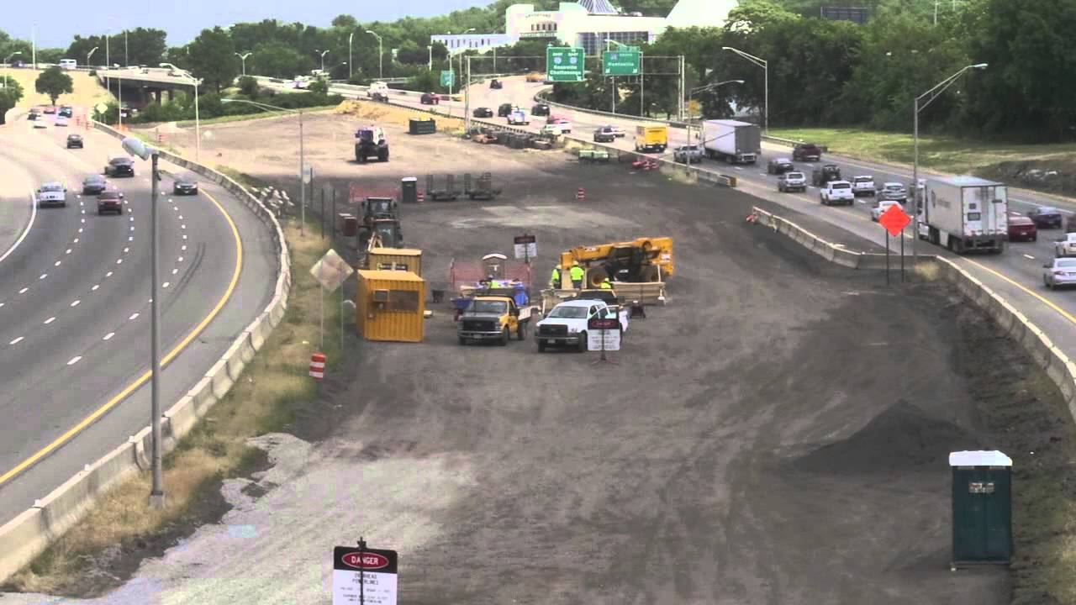
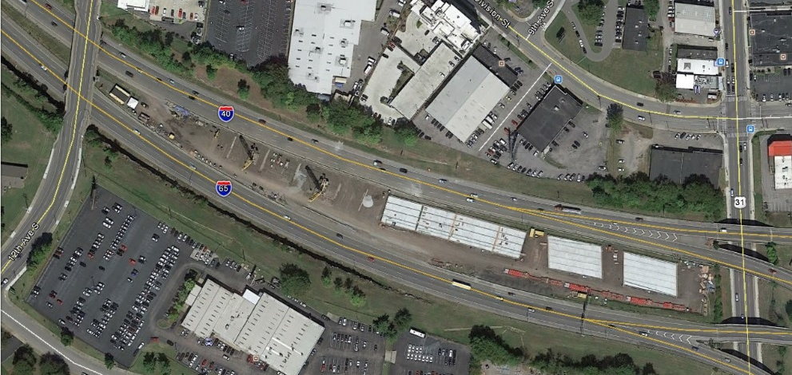
Why use abc technologies?
Bridge Farm Concept Implementation for Fast Fix 8 in Nashville, TN

Slide 8
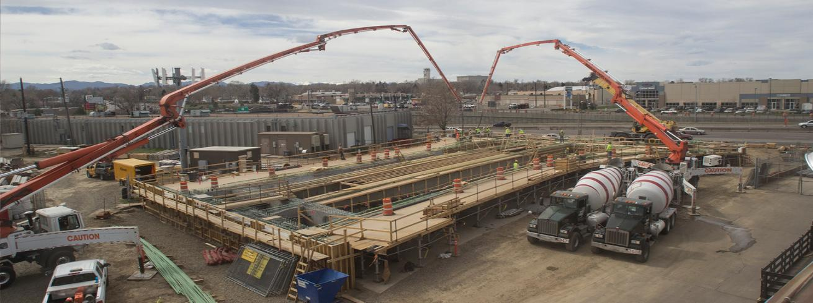
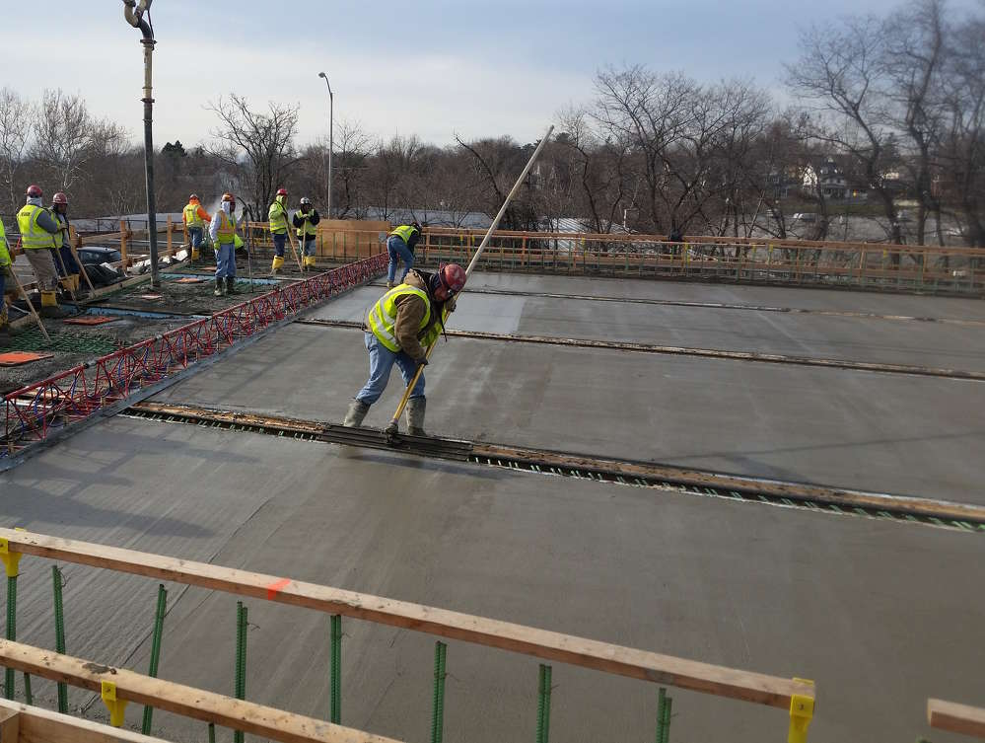
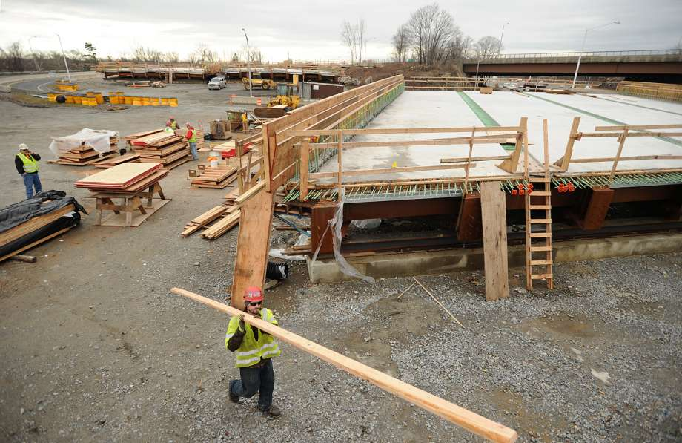
Why use abc technologies?
Deck Forming – Continuous Placement

Slide 9
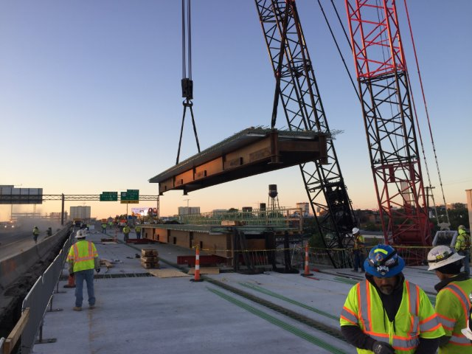
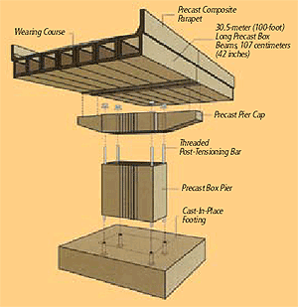
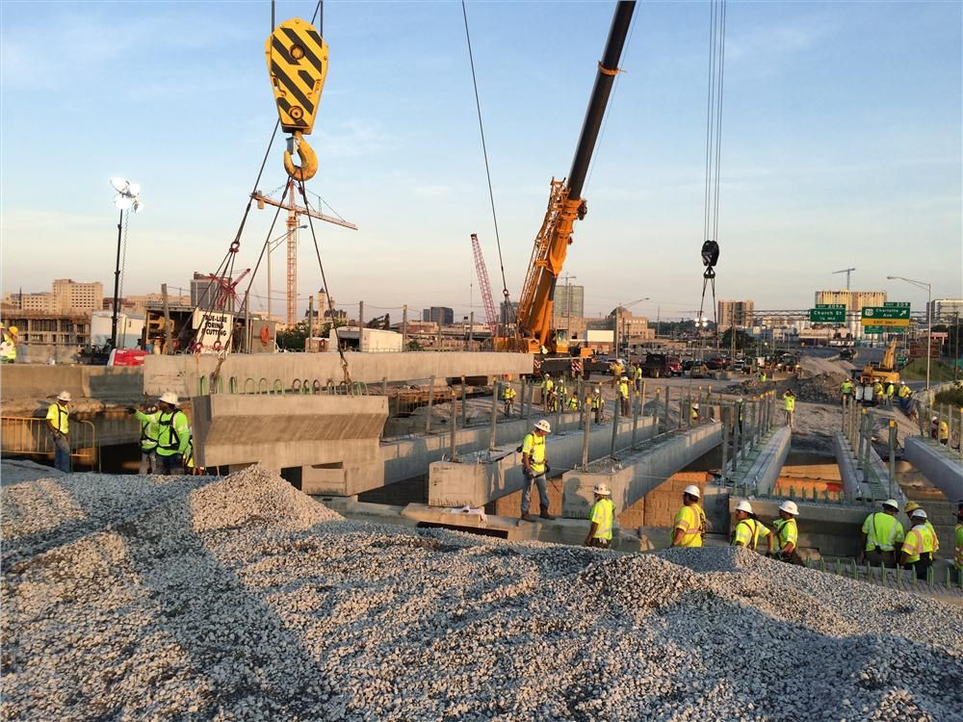
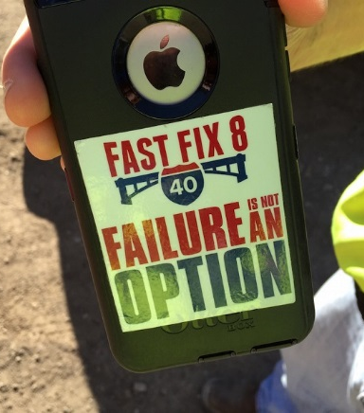
Why use abc technologies?
Precast Abutments, Piers, and Superstructure Modules

Slide 10
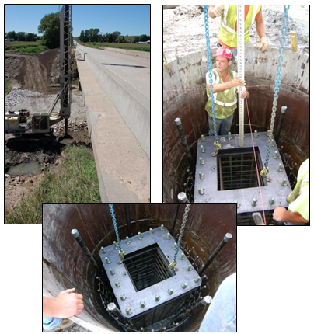
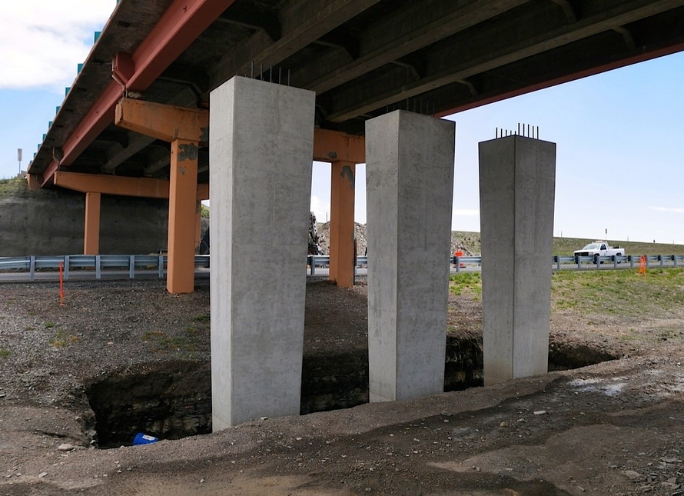
Why use abc technologies?
Foundation Layout Prior to Demolition

Slide 11
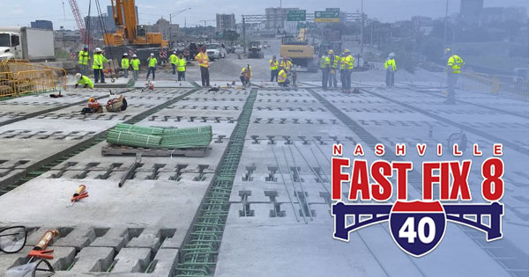
Why use abc technologies?
Superstructure Module Assembly

Slide 12
Time metrics for abc
To gauge the effectiveness of ABC, two time metrics are used:
Onsite Construction Time:
The period of time from when a contractor alters the project site location until all construction-related activity is removed.
Mobility Impact Time:
Any period of time the traffic flow of the transportation network is reduced due to onsite construction activities.
Tier 1: Traffic Impacts (Weekend)
Tier 2: Traffic Impacts (Few Weeks)
Tier 3: Traffic Impacts (Months)

Slide 13
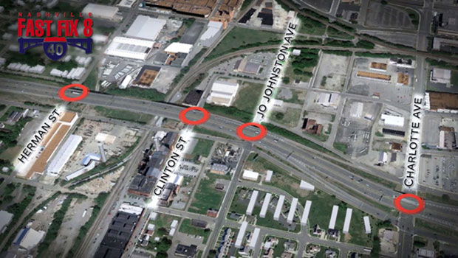
Tdot incorporates abc techniques

Slide 14
Tdot incorporates abc techniques
First CMGC project for TDOT in which the contractor was involved early in the design process
Completed in four months and 10 weekends
Fast Fix 8 Project is up for AASHTO’s 2016 America’s Transportation Award (Top 12 out of 84 projects last spring)

Slide 15
Why use abc technologies?

Slide 16
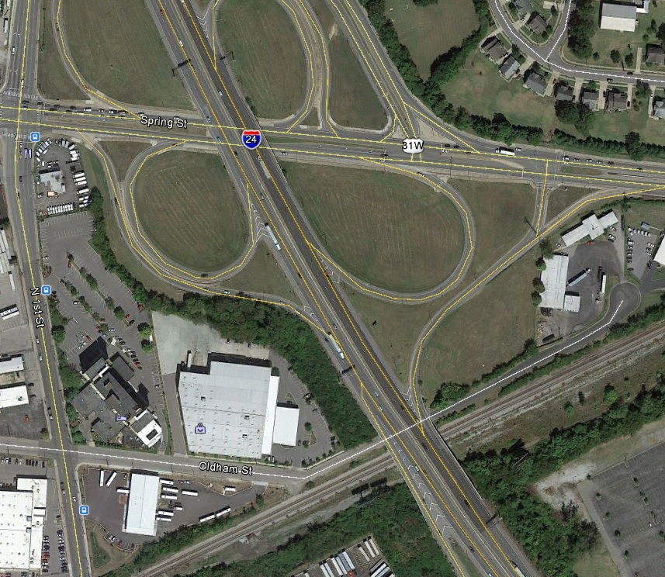
Future Tdot abc projects
Two I-24 Bridges in the downtown Nashville, TN loop
I-24 at Spring Street
I-24 at Oldham Street and CSX Railroad

Slide 17
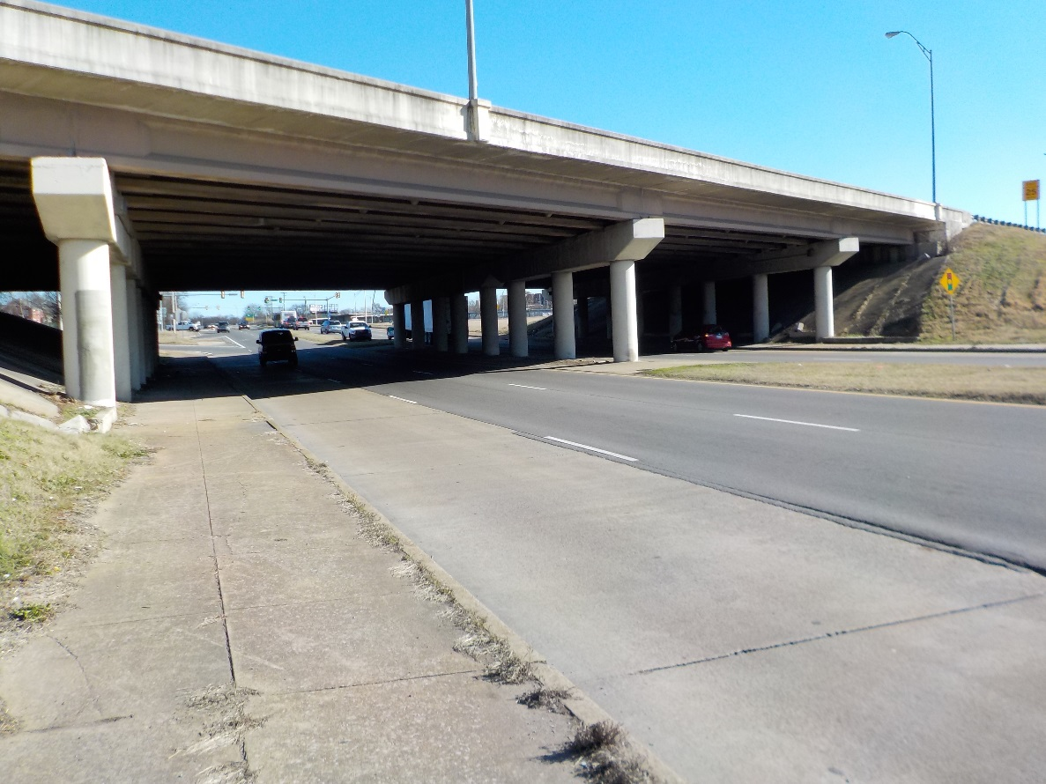
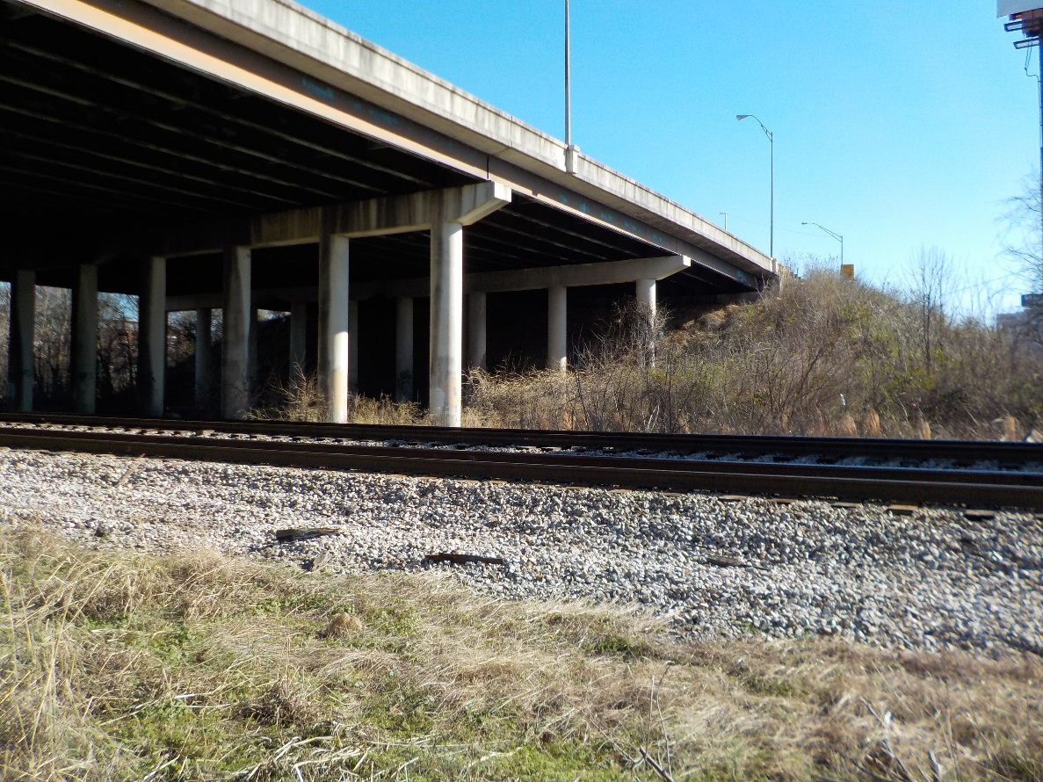
Future Tdot abc projects
I-24 at Spring Street
I-24 at Oldham Street & CSX Railroad

Slide 18
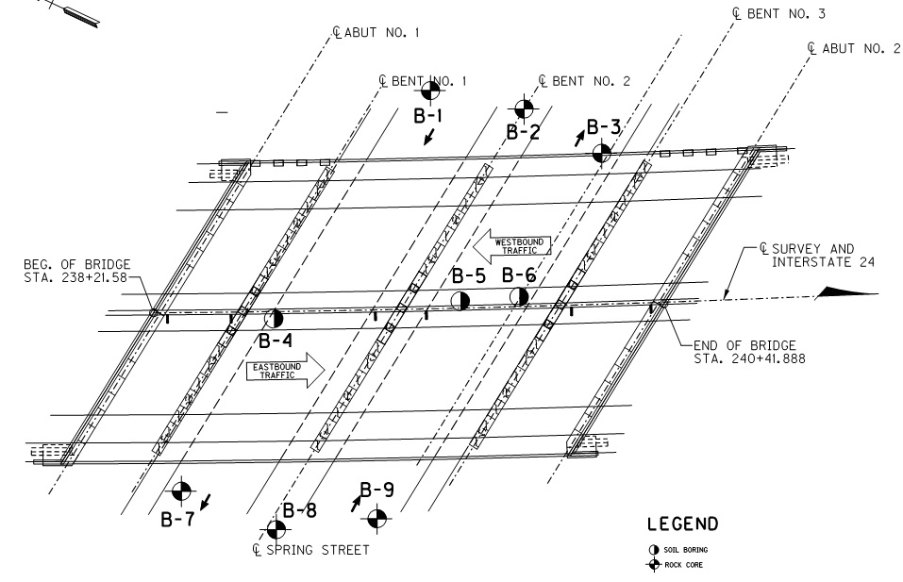
Future Tdot abc projects
I-24 at Spring Street
Accelerated Schedule
TDOT WO: 2-18-16
Coordination (2-18-16 to 2-24-16)
Field activities (2-25-16 to 3-3-16)
8 a.m. to 3p.m.
9 borings
120 feet rock coring
Low headroom under bridge
Concrete coring

Slide 19
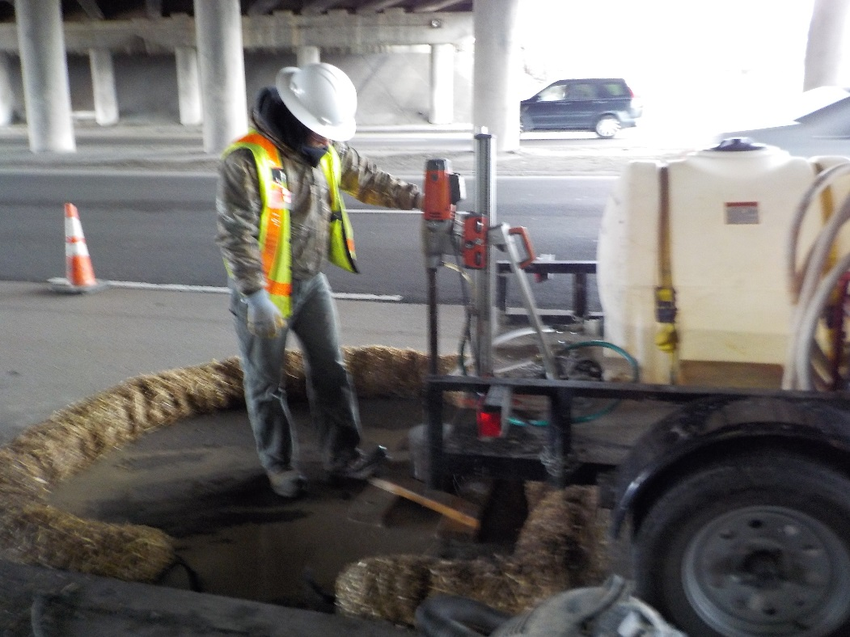
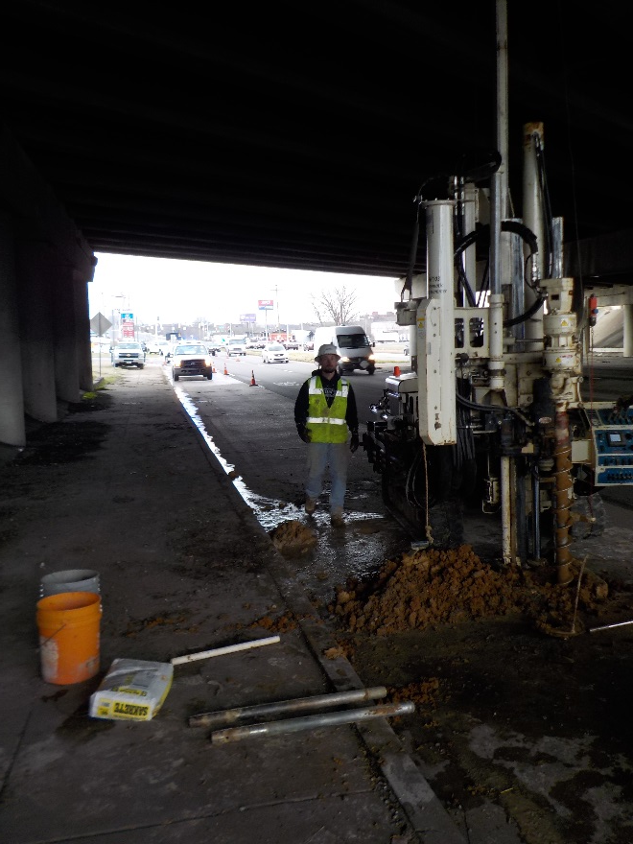
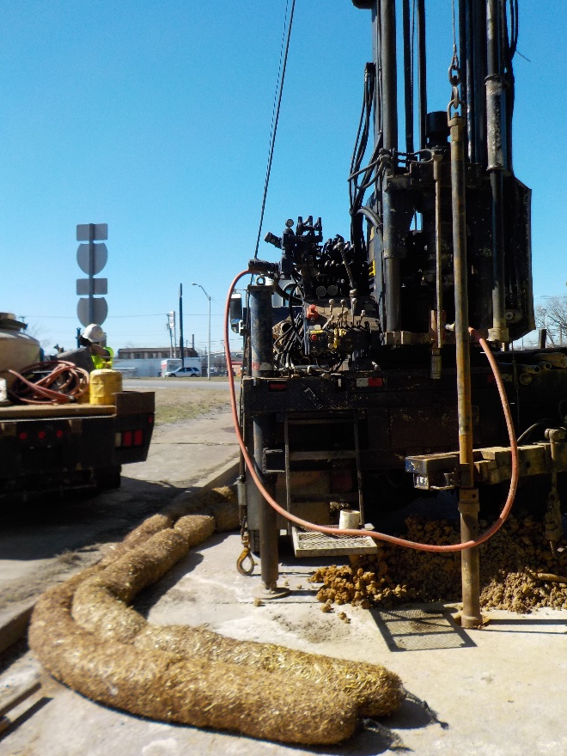
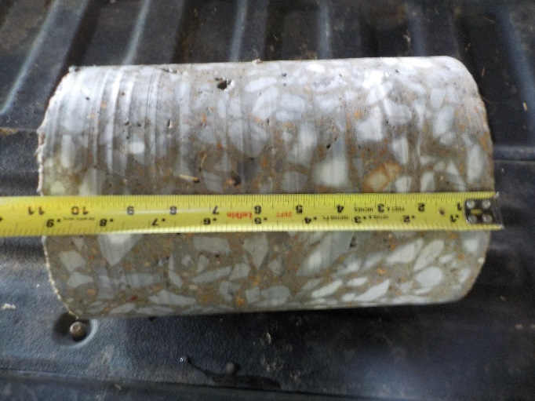
Future Tdot abc projects
I-24 at Spring Street

Slide 20
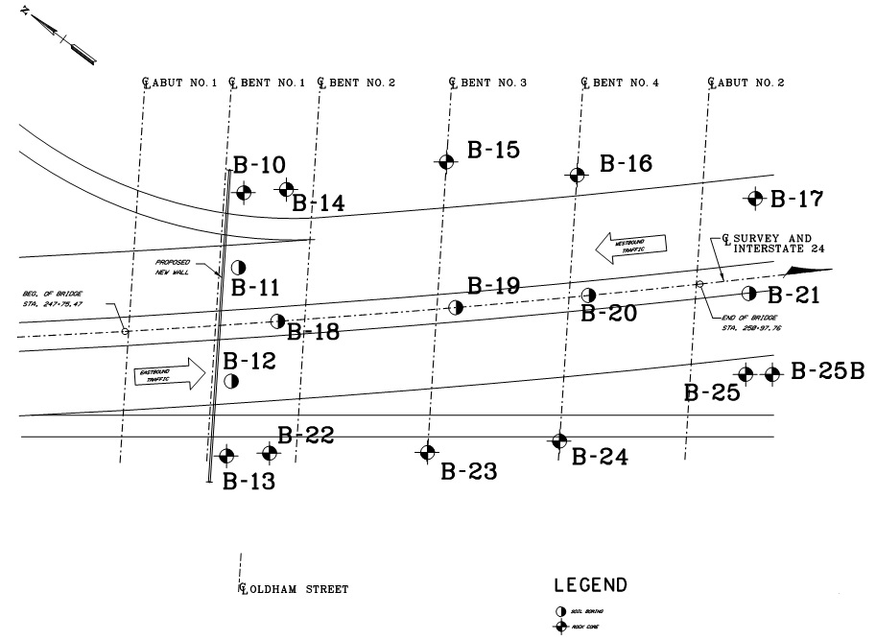
Future Tdot abc projects
I-24 at Oldham Street & CSX
Accelerated Schedule
Coordination (2-18-16 to 2-24-16)
Field activities (2-26-16 to 6-8-16)*CSX delays
Day/night drilling
Only 14 days of actual drilling
16 borings
200 feet rock coring
Drilling under bridge
Asphalt coring

Slide 21
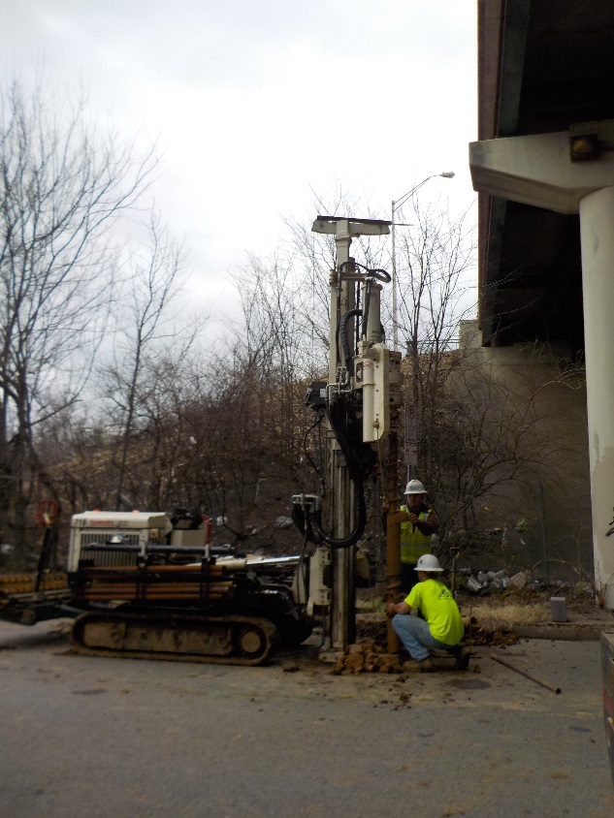
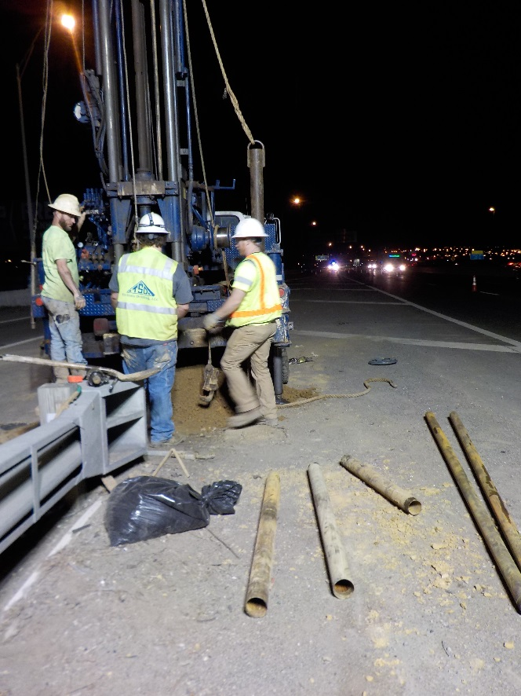
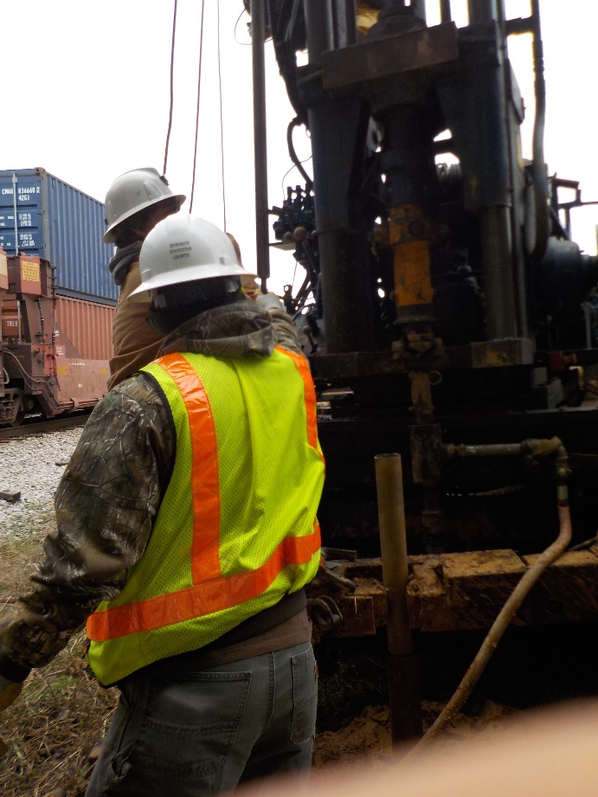
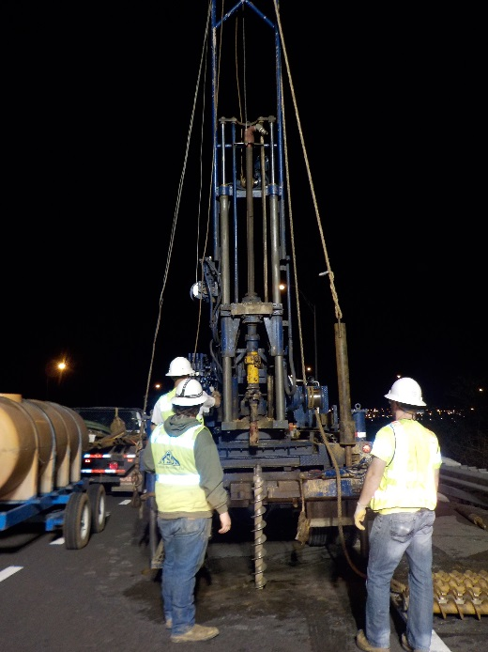
Future Tdot abc projects
I-24 at Oldham Street & CSX

Slide 22
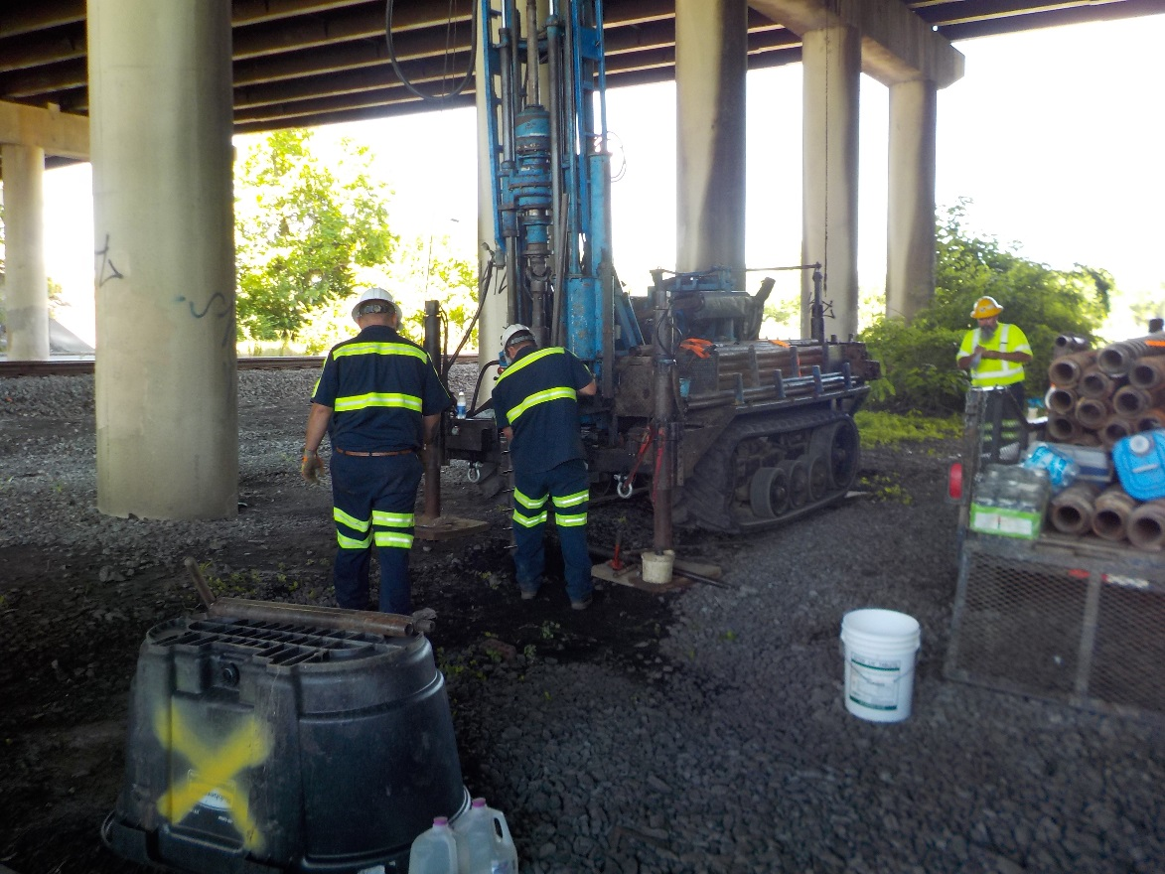
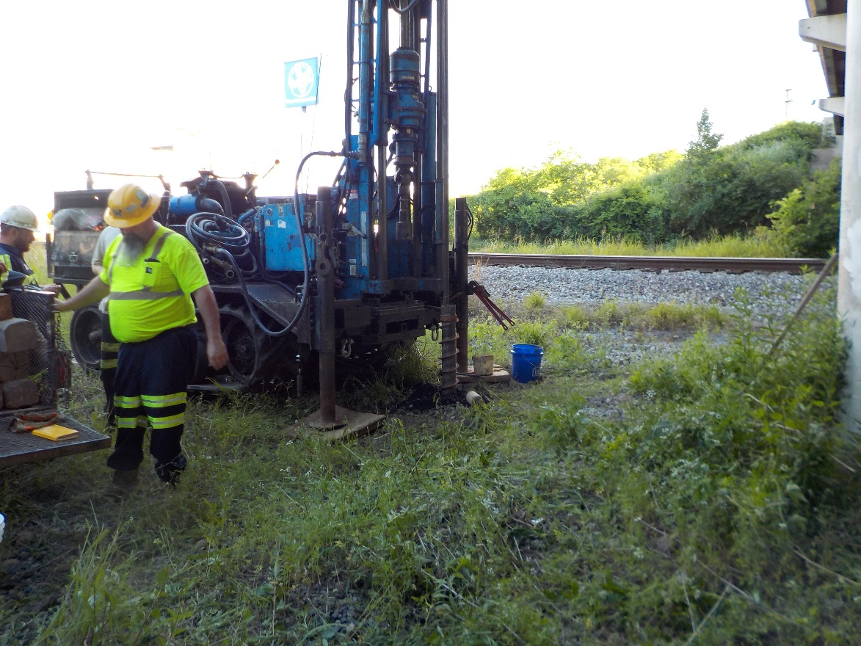
Future Tdot abc projects
I-24 at Oldham Street & CSX

Slide 23
Thanks
Aaron Crowley, Ph.D. KSWA
Travis Smith, P.E. TDOT
Biloxi, Mississippi
November 8, 2016

Slide 24
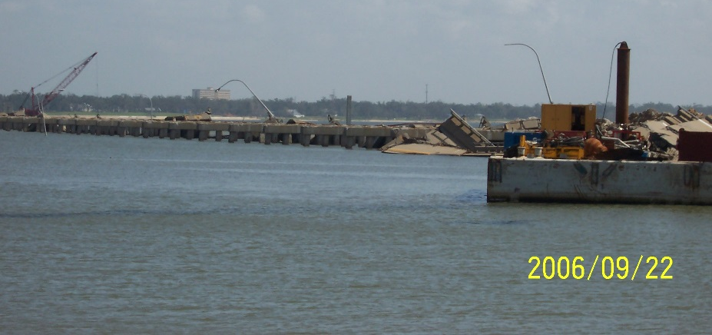
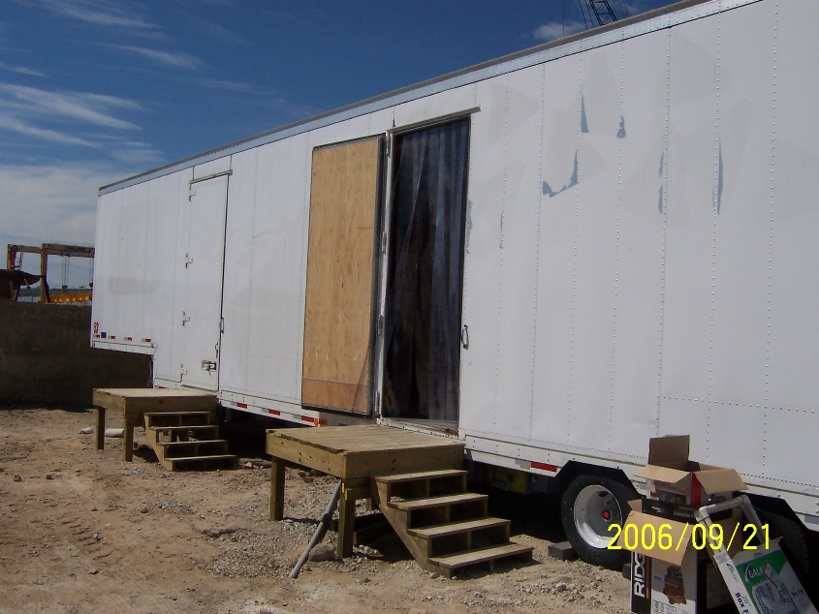
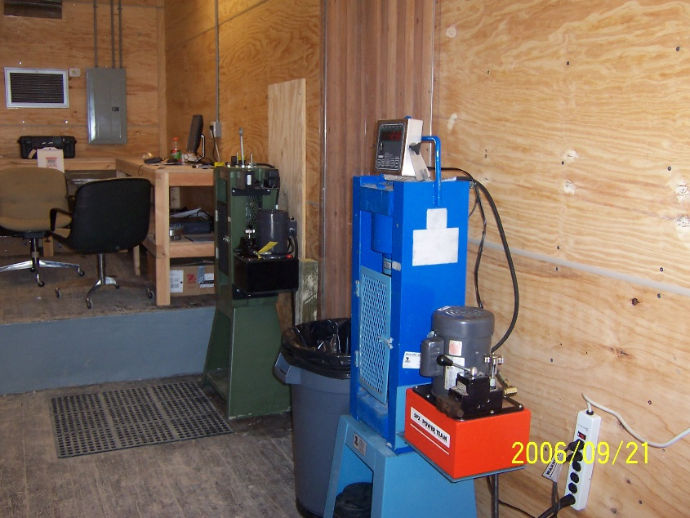
Fun fact: Biloxi bridge

